Slide 1

ICT502
Week 11: Project Management Principles and Practices
ICT502 Applied IT Project A
1

Slide 2
What we learned last week
Ethics of Emerging Technologies
Ethical Decision-Making in Project Management
IT Governance and Compliance
Managing Stakeholder Expectations and Relationships

Slide 3
Week 10 Pre-Class Readings
YouTube Video:
AGILE versus WATERFALL Project Plans
https://www.youtube.com/watch?v=3KgjfqiN2fE

Slide 4
Week 10 Pre-Class Readings
Key Lessons / Messages from the Video
1. Agile and Waterfall have the same goal
Both methods aim to successfully deliver a project.
The difference is how the work is organised and managed.
- Waterfall: Plan most things at the beginning.
- Agile: Deliver work in small steps and adjust as you go.

Slide 5
Week 10 Pre-Class Readings
2. Agile is not a shortcut
Some people think Agile means less planning.
This is not true.
Even in Agile projects, teams still need to manage:
- Scope
- Time
- Cost
- Quality
- Risks
- Stakeholders
- Communication
The responsibilities remain the same.

Slide 6
Week 10 Pre-Class Readings
3. Waterfall focuses more on documentation
Waterfall projects usually create:
- Business cases
- Project charters
- Requirement documents
- Schedules
- Risk registers
- Communication plans
Everything is documented and approved before major work begins.

Slide 7
Week 10 Pre-Class Readings
4. Agile focuses more on people and collaboration
Agile relies on:
- Team communication
- Customer feedback
- Short development cycles
- Continuous improvement

Slide 8
Week 10 Pre-Class Readings
Instead of large documents, Agile uses:
- Team charters
- Product backlogs
- User stories
- Sprint planning
- Sprint reviews
The customer is involved throughout the project.

Slide 9
Week 10 Pre-Class Readings
5. Stakeholder communication is critical
Projects succeed when stakeholders:
- Understand their roles
- Receive regular updates
- Provide feedback
Agile encourages more frequent communication through daily meetings and reviews.

Slide 10
Week 10 Pre-Class Readings
6. Requirements must be understood clearly
Before building a solution, project teams must understand:
- Customer needs
- Business problems
- User expectations
Waterfall often uses detailed requirement documents.

Slide 11
Week 10 Pre-Class Readings
Agile often uses:
- User stories
- Prototypes
- Mock-ups
- Customer feedback sessions
to understand requirements better.

Slide 12
Week 10 Pre-Class Readings
7. Agile welcomes change
Waterfall prefers stable requirements.
Agile accepts that requirements may change as customers learn more about what they need.
This flexibility helps teams deliver greater customer value.

Slide 13
Week 10 Pre-Class Readings
8. Quality should be checked regularly
Waterfall often tests near the end of the project.
Agile tests continuously throughout development.
This helps identify problems earlier and reduces rework.

Slide 14
Week 10 Pre-Class Readings
9. Risks must always be managed
Regardless of methodology, project managers must:
- Identify risks
- Assess risks
- Monitor risks
- Reduce risks
Risk management is important in both Agile and Waterfall projects.

Slide 15
Week 10 Pre-Class Readings
10. Project success depends on teamwork
Successful projects require:
- Good communication
- Collaboration
- Shared goals
- Clear responsibilities
People are often more important than processes or tools.

Slide 16
Working with NSW IT Support
Choosing a Project Management Methodology
Question for NSW IT Support
- Do you mainly use Agile, Waterfall, or a combination?
- Which projects suit Agile best?
- Which projects suit Waterfall best?
- What project management tools do you use?

Slide 17
Working with NSW IT Support
Possible Australian Industry Answer
- Agile for software development and cloud projects.
- Waterfall for infrastructure upgrades and compliance projects.
- Hybrid approach is common.

Slide 18
Working with NSW IT Support
Project Planning Challenges
Questions to Ask
- What planning challenges do your clients face?
- How do project delays occur?
- How do you estimate project timelines?

Slide 19
Working with NSW IT Support
Possible Challenges
- Unclear requirements.
- Scope changes.
- Limited resources.
- Client communication issues.

Slide 20
Working with NSW IT Support
Possible Solutions
- Better requirement gathering.
- Regular client meetings.
- Clear project scope documentation.
- Agile sprint planning.

Slide 21
Working with NSW IT Support
Scheduling and Resource Management
Questions to Ask
- How do you allocate staff to projects?
- How do you manage resource shortages?
- How do you monitor project progress?

Slide 22
Working with NSW IT Support
Potential Solutions
- Resource planning tools.
- Weekly status meetings.
- Project dashboards.
- Workload balancing.

Slide 23
Working with NSW IT Support
Tools Used in Real Projects
Questions to Ask
- Which project management tools do you use?
- Why were those tools selected?
- What benefits do they provide?

Slide 24
Working with NSW IT Support
Common Industry Tools
- Jira
- Trello
- Microsoft Project
- Monday.com
- Asana
- Microsoft Teams
- SharePoint

Slide 25
Working with NSW IT Support
Communication and Collaboration
Questions to Ask
- How do you communicate with clients?
- How often are project updates provided?
- What causes communication failures?

Slide 26
Working with NSW IT Support
Solutions
- Weekly meetings.
- Shared dashboards.
- Progress reports.
- Clear escalation procedures.

Slide 27
Working with NSW IT Support
Challenges Facing Australian IT Projects
Questions to Ask
- What project risks are most common in Australia?
- What causes project failure?

Slide 28
Working with NSW IT Support
Common Challenges
- Cybersecurity threats.
- Budget constraints.
- Staff shortages.
- Compliance requirements.
- Changing client requirements.

Slide 29
Working with NSW IT Support
Possible Solutions
- Early risk assessment.
- Agile project management.
- Staff training.
- Security reviews.

Slide 30
Working with NSW IT Support
Questions Students Can Use for Assessment 4
Project Management
- How do you manage IT projects from start to finish?
- Do you use Agile, Waterfall, or Hybrid?
- What project management software do you use?

Slide 31
Working with NSW IT Support
Resource Management
- How do you allocate resources?
- How do you manage multiple projects simultaneously?

Slide 32
Working with NSW IT Support
Communication
- How do you communicate with clients and stakeholders?
- What communication challenges occur most often?

Slide 33
Working with NSW IT Support
Risk Management
- What are the biggest risks in IT projects?
- How do you manage cybersecurity risks?

Slide 34
Working with NSW IT Support
Future Trends
- How are AI and automation changing project management?
- What project management skills are most important for graduates?

Slide 35
Discussion Questions
Q1. What is the main difference between Agile and Waterfall?
Waterfall plans most work before development begins. Agile delivers work in small stages and allows changes during the project.

Slide 36
Discussion Questions
Q2. Does Agile eliminate planning?
No. Agile still requires planning, but planning happens continuously throughout the project.

Slide 37
Discussion Questions
Q3. Why is customer feedback important in Agile?
Customer feedback helps teams improve the product and ensure it meets user needs.

Slide 38
Discussion Questions
Q4. Why is communication important in project management?
Good communication reduces misunderstandings, improves teamwork, and helps projects stay on track.

Slide 39
Discussion Questions
Q5. What project management tools are commonly used in industry?
Jira, Trello, Microsoft Project, Monday.com, Asana, Microsoft Teams, and SharePoint.

Slide 40
Discussion Questions
Q6. What are common reasons IT projects fail?
Poor planning, unclear requirements, weak communication, scope creep, and inadequate risk management.

Slide 41
Discussion Questions
Q7. Why is risk management important?
Risk management helps identify potential problems early and reduces the chance of project failure.

Slide 42
Discussion Questions
Q8. Which methodology is better: Agile or Waterfall?
Neither is always better. The best choice depends on the project type, customer requirements, and business environment.

Slide 43
Discussion Questions
Q9. How can NSW IT Support help students with Assessment 4?
They can provide real-world insights about project management methods, project challenges, communication practices, resource management, cybersecurity concerns, and industry tools.

Slide 44
Discussion Questions
Q10. What is the most important lesson from this video?
Regardless of whether a project uses Agile or Waterfall, successful projects require good planning, communication, stakeholder management, quality control, and teamwork.

Slide 45
Week 10 Topics
Project management methodologies (Agile, Waterfall).
Key project management skills (planning, scheduling, resource management)
Tools and software for project management

Slide 46
Pre-Class Discussion
YouTube Video: (Watch)
What is Project Management?
https://www.youtube.com/watch?v=5cO5nHmMxrw

Slide 47
Pre-Class Discussion
Key Lessons / Messages from the Video
1. Project Management is a Process
Project management is a structured process used to help teams achieve specific goals and deliverables successfully.
It ensures that projects are:
- Organised
- Controlled
- Delivered on time
- Delivered within budget
- Aligned with stakeholder expectations

Slide 48
Pre-Class Discussion
Key Message:
Project management provides the roadmap that guides a project from idea to completion.

Slide 49
Pre-Class Discussion
2. Projects Have a Clear Beginning and End
A project is different from daily operations because it has:
- A specific objective
- A defined start date
- A defined finish date
- Specific deliverables

Slide 50
Pre-Class Discussion
Examples include:
- Software development
- Product launches
- Construction projects
- Process improvements
- IT system upgrades
Key Message:
Projects are temporary efforts designed to create a unique outcome.

Slide 51
Pre-Class Discussion
3. Projects Require Teamwork
Projects often involve multiple subject matter experts (SMEs) working together.
Examples:
- Business Analysts
- Developers
- Cyber Security Specialists
- Database Designers
- Project Managers
- End Users

Slide 52
Pre-Class Discussion
Key Message:
Successful projects depend on collaboration between people with different expertise.

Slide 53
Pre-Class Discussion
4. Project Management Helps Control Scope, Time, and Budget
One of the main responsibilities of project management is balancing:
- Scope (what will be delivered)
- Time (when it will be delivered)
- Budget (how much it costs)

Slide 54
Pre-Class Discussion
Key Message:
Good project management prevents projects from becoming too expensive, too late, or too large.

Slide 55
Pre-Class Discussion
5. Communication is Critical
Project managers communicate with:
- Team members
- Customers
- Sponsors
- Stakeholders
- Management

Slide 56
Pre-Class Discussion
Communication ensures:
- Everyone understands objectives
- Issues are identified early
- Expectations are managed
Key Message:
Poor communication is one of the most common causes of project failure.

Slide 57
Pre-Class Discussion
6. Risk Management is Essential
Every project faces risks.
Examples:
- Budget overruns
- Security breaches
- Resource shortages
- Technical failures
- Schedule delays

Slide 58
Pre-Class Discussion
Project managers must:
- Identify risks
- Analyse risks
- Monitor risks
- Develop mitigation plans
Key Message:
Managing risks early increases project success.

Slide 59
Pre-Class Discussion
7. Change Management is Important
Projects often introduce new systems or processes.
Users may resist change.
Change management helps organisations:
- Prepare users
- Train staff
- Communicate benefits
- Support adoption

Slide 60
Pre-Class Discussion
Key Message:
Technology projects succeed when people are willing to use the solution.

Slide 61
Pre-Class Discussion
8. Every Project Follows a Life Cycle
The video explains the five major stages of project management:
Stage 1: Initiation
Questions asked:
- Why are we doing this project?
- What problem are we solving?
- Is the project worthwhile?

Slide 62
Pre-Class Discussion
Deliverables:
- Business case
- Initial scope
- Project justification

Slide 63
Pre-Class Discussion
Planning
Questions asked:
- What work needs to be done?
- Who will do it?
- When will it be completed?
Deliverables:
- Project charter
- Schedule
- Resource plan
- Risk plan

Slide 64
Pre-Class Discussion
Stage 3: Execution
The actual work begins.
This is where methodologies such as:
- Agile
- Waterfall
- Hybrid
are applied.
Key Message:
Methodologies are mainly used during project execution

Slide 65
Pre-Class Discussion
Stage 4: Monitoring and Controlling
Project managers monitor:
- Progress
- Risks
- Costs
- Quality
- Changes
Adjustments are made when needed.
Key Message:
Projects must be continuously monitored to stay on track.

Slide 66
Pre-Class Discussion
Stage 5: Closing
Project teams:
- Finalise deliverables
- Document lessons learned
- Complete reports
- Close contracts
Key Message:
Closing helps organisations improve future projects.

Slide 67
Pre-Class Discussion
9. Agile and Waterfall Are Execution Approaches
The video highlights an important misconception:
Many people think Agile replaces project management.
It does not.
Projects still require:
- Initiation
- Planning
- Monitoring
- Closing

Slide 68
Pre-Class Discussion
Agile mainly influences how work is executed.
Key Message:
Agile is a project delivery methodology, not a replacement for project management.

Slide 69
Pre-Class Discussion
10. Project Management is Critical for Organisational Success
Without project management:
- Projects may exceed budgets
- Deadlines may be missed
- Risks may increase
- Stakeholders may become dissatisfied

Slide 70
Pre-Class Discussion
Key Message:
Project management transforms business ideas into successful outcomes.

Slide 71
Week 11 Assessment 4 Connection
NSW IT Support Company Example
Students communicating with a NSW IT Support company could ask questions such as:
Project Initiation
- How do you decide whether an IT project should proceed?
- How do you define project objectives?
- How do you justify project investments?

Slide 72
Week 11 Assessment 4 Connection
Project Planning
- How do you estimate project timelines?
- How do you estimate project costs?
- How do you allocate resources?

Slide 73
Week 11 Assessment 4 Connection
Project Methodology
- Do you use Agile, Waterfall, or Hybrid methods?
- Why do you choose one methodology over another?
- What factors influence your decision?

Slide 74
Week 11 Assessment 4 Connection
Risk Management
- What are the most common risks in Australian IT projects?
- How do you manage cybersecurity risks?
- How do you handle project delays?

Slide 75
Week 11 Assessment 4 Connection
Communication
- How often do you communicate with clients?
- What communication tools do you use?
- How do you manage stakeholder expectations?

Slide 76
Week 11 Assessment 4 Connection
Project Tools
- Do you use Jira?
- Do you use Microsoft Project?
- Do you use Trello or Asana?
- Which tool works best for your projects?

Slide 77
Week 11 Assessment 4 Connection
Lessons Learned
- What is the most common reason IT projects fail?
- What project management skills are most valuable?
- What advice would you give ICT students entering the industry?

Slide 78
Discussion Questions
Q1. What is project management?
Project management is the process of planning, organising, monitoring, and controlling resources to achieve specific project goals.

Slide 79
Discussion Questions
Q2. What are the three main project constraints?
The three main constraints are:
- Scope
- Time
- Cost
These are often called the Project Management Triangle.

Slide 80
Discussion Questions
Q3. Why is communication important in project management?
Communication ensures stakeholders understand project goals, progress, risks, and changes, reducing misunderstandings and project failures.

Slide 81
Discussion Questions
Q4. What is the purpose of risk management?
Risk management identifies potential problems before they occur and develops strategies to reduce their impact.

Slide 82
Discussion Questions
Q5. What are the five phases of the project life cycle?
Initiation
Planning
Execution
Monitoring and Controlling
Closing

Slide 83
Discussion Questions
Q6. What is the difference between Agile and Waterfall?
- Waterfall follows a structured, sequential approach.
- Agile delivers work in small increments and adapts to changing requirements.

Slide 84
Discussion Questions
Q7. Why is project planning important?
Planning helps define project objectives, schedules, budgets, resources, and risks before execution begins.

Slide 85
Discussion Questions
Q8. What role do stakeholders play in projects?
Stakeholders provide requirements, feedback, approvals, resources, and support throughout the project lifecycle.

Slide 86
Discussion Questions
Q9. Why is project closure important?
Closure captures lessons learned, confirms deliverables are completed, and helps improve future projects.

Slide 87
Discussion Questions
Q10. How can project management improve IT project success?
Project management provides structure, communication, risk control, resource management, and monitoring processes that increase the likelihood of delivering successful IT solutions.

Slide 88
Reflection Question for Assessment 4
Based on your discussion with the NSW IT Support company, which project management methodology (Agile, Waterfall, or Hybrid) would be most suitable for your proposed solution, and why?

Slide 89
Reflection Question for Assessment 4
A Hybrid methodology would be most suitable because it combines the structured planning and documentation of Waterfall with the flexibility and customer feedback cycles of Agile. This approach supports effective stakeholder communication, risk management, and continuous improvement while ensuring project objectives remain aligned with business requirements.

Slide 90
Project management methodologies
Understanding Project Management Methodologies
Project management methodologies are structured approaches that guide how projects are planned, executed, monitored, and closed.
These methodologies provide frameworks to ensure projects meet objectives efficiently within given constraints.
Significance of Methodology Selection
Choosing the right methodology is crucial for project success, aligning project practices with organisational goals and enhancing team collaboration.
Factors influencing methodology selection include project complexity, team dynamics, and organisational culture.

Slide 91
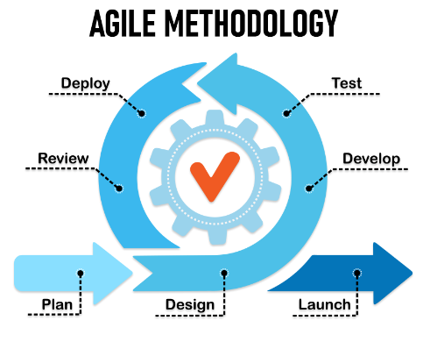
Project management methodologies: Agile

Slide 92
Project management methodologies: Agile (cont.)
Overview of Agile Methodology
Agile methodologies originated as a response to traditional, plan-driven approaches (like Waterfall), focusing on iterative development, flexibility, and customer collaboration.
Agile is characterised by its iterative cycles (sprints), continuous feedback loops, and the ability to adapt to changing requirements throughout the project lifecycle.
Agile frameworks, such as Scrum and Kanban, emphasise teamwork, self-organisation, and delivering incremental value to stakeholders.

Slide 93
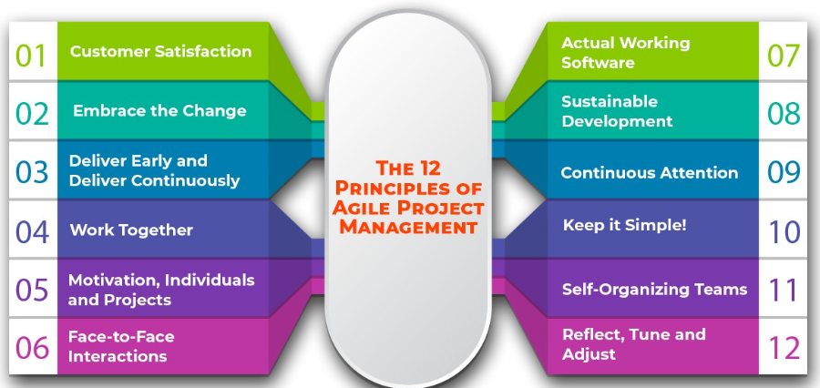
Project management methodologies: Agile (cont.)

Slide 94
Project management methodologies: Agile (cont.)
Advantages of Agile Methodology
Flexibility: Iterative development allows for adapting to changing requirements and market conditions quickly.
Customer Collaboration: Continuous feedback ensures alignment with customer expectations and delivers value-driven solutions.
Faster Time-to-Market: Incremental delivery enables quicker adaptation to market needs and competitive pressures.
Improved Quality: Continuous testing and integration result in higher product quality and customer satisfaction.
Enhanced Team Collaboration: Cross-functional teams collaborate effectively in self-organising units.

Slide 95
Project management methodologies: Agile (cont.)
Challenges of Agile Methodology
Managing Scope: Prioritising features and managing scope creep during iterative development.
Documentation Balance: Agile values working software over comprehensive documentation.
Team Skills: Teams need training and experience in agile practices and frameworks.
Resistance to Change: Organisational culture may resist agile principles and practices.
Scalability: Scaling agile practices across large projects or distributed teams can be challenging.

Slide 96
Project management methodologies: Waterfall
Overview of Waterfall Methodology
Waterfall methodology is a sequential project management approach that follows a linear and structured process flow. It is characterised by its distinct phases, where progress flows downwards (like a waterfall) through each phase before proceeding to the next.

Slide 97
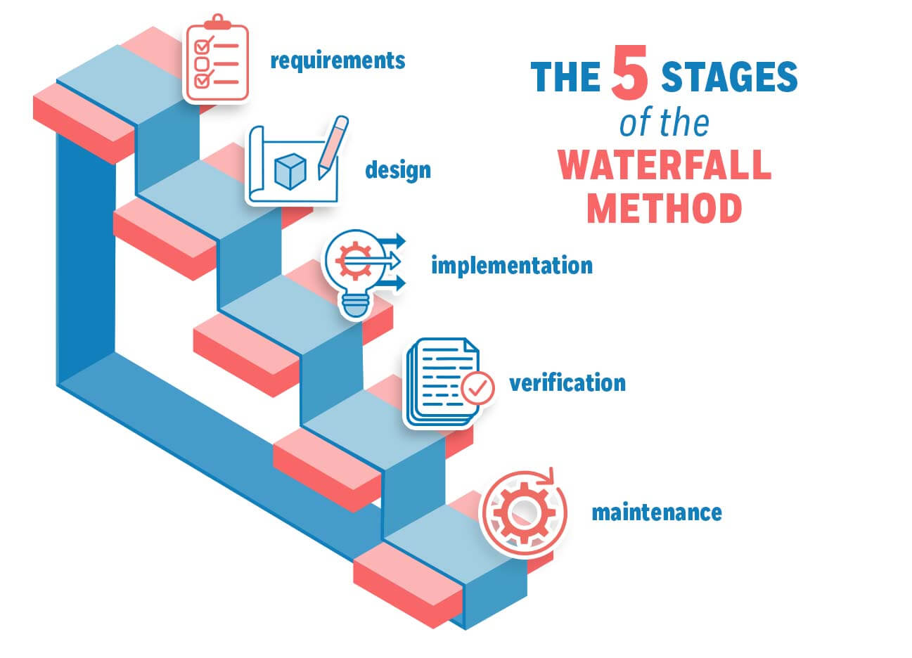
Project management methodologies: Waterfall (cont.)

Slide 98
Project management methodologies: Waterfall (cont.)
Phases of Waterfall Methodology
Requirements Gathering:
Initial phase where project requirements are gathered and documented in detail.
Emphasis on capturing all stakeholder expectations and project scope.
System Design:
Detailed system architecture and design planning based on gathered requirements.
Documentation includes system specifications, diagrams, and software architecture.
Implementation:
Development phase where the actual system or product is constructed based on the design specifications.
Sequential progression from coding to unit testing to ensure each component meets requirements.

Slide 99
Project management methodologies: Waterfall (cont.)
Advantages of Waterfall Methodology
Clarity and Structure:
Clearly defined phases and deliverables provide a structured approach to project management.
Well-suited for projects with stable requirements and predictable outcomes.
Challenges of Waterfall Methodology
Limited Flexibility:
Lack of flexibility to accommodate changes once a phase is complete.
Challenges in adapting to evolving requirements or unforeseen issues during later stages.

Slide 100
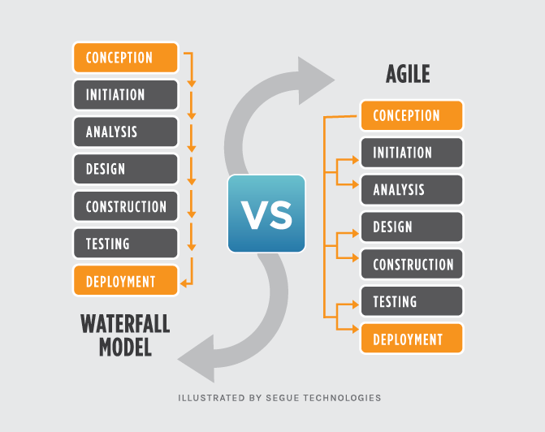
Project management methodologies: Waterfall vs. Agile

Slide 101
Key project management skills: Planning
Introduction to Planning
Definition: Planning in project management involves outlining the steps needed to achieve project goals and objectives.
Importance: Establishes project scope, timelines, and deliverables, ensuring clarity and direction for the project team.

Slide 102
Key project management skills: Planning (cont.)
Key Elements of Planning
Scope Definition:
Identifying project objectives, requirements, and deliverables.
Establishing boundaries and determining what is included and excluded from the project scope.
Work Breakdown Structure (WBS):
Hierarchical decomposition of project tasks into smaller, manageable components.
Helps in organising and planning project activities and assigning responsibilities.
Risk Management Planning:
Identifying potential risks and developing strategies to mitigate them.
Ensuring proactive risk management throughout the project lifecycle.

Slide 103
Key project management skills: Scheduling
Introduction to Scheduling
Definition: Scheduling involves determining the start and finish dates for project activities and milestones.
Purpose: Ensures timely completion of tasks and adherence to project timelines.

Slide 104
Key project management skills: Scheduling (cont.)
Techniques for Project Scheduling
Task Sequencing:
Establishing logical relationships between project tasks (e.g., finish-to-start, start-to-start).
Determining dependencies to ensure tasks are completed in the correct order.
Estimating Durations:
Predicting the time required to complete each project activity.
Using historical data, expert judgment, and analogies for accurate duration estimation.
Resource Allocation:
Assigning resources (human, equipment, materials) to project tasks.
Balancing resource availability and workload to prevent overallocation or bottlenecks.

Slide 105
Key project management skills: Resource Management
Introduction to Resource Management
Definition: Resource management involves effectively allocating, utilising, and monitoring resources throughout the project lifecycle.
Objective: Maximises resource efficiency while meeting project goals and requirements.

Slide 106
Key project management skills: Resource Management (cont.)
Key Aspects of Resource Management
Resource Planning:
Identifying project resource requirements (human, equipment, materials).
Developing strategies to acquire and allocate resources as per project needs.
Resource Allocation:
Assigning resources to project tasks based on skills, availability, and priority.
Balancing workload to prevent resource overallocation and optimise productivity.
Resource Tracking and Optimisation:
Monitoring resource utilisation and performance.
Adjusting resource allocation as project requirements evolve or change.

Slide 107
Tools and Software for Project Management
Types of Project Management Tools
Task Management Tools:
Features: Create, assign, and track tasks; set deadlines and priorities; collaborate on task status.
Examples: Asana, Trello, Jira.
Collaboration Tools:
Features: Facilitate team communication, file sharing, real-time editing, and document management.
Examples: Microsoft Teams, Slack, Google Workspace.
Scheduling Tools:
Features: Create project timelines, manage dependencies, allocate resources, and monitor progress.
Examples: Microsoft Project, Smartsheet, Monday.com.

Slide 108
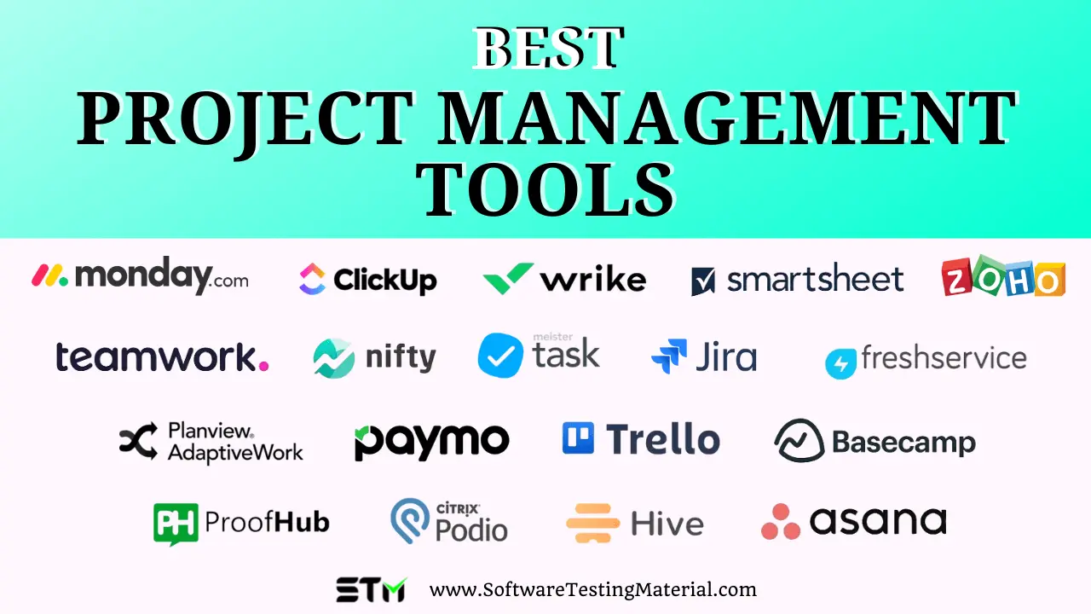
Tools and Software for Project Management

Slide 109
Group Discussion Case Study
Scenario: Implementing a Software Upgrade Project
You are leading a team responsible for implementing a major software upgrade project for a multinational corporation. The project aims to enhance the functionality and security of the company's enterprise resource planning (ERP) system. The upgrade involves integrating new modules, improving user interface design, and ensuring compatibility with existing databases and third-party applications. The timeline for the project is nine months, with a strict budget and phased delivery milestones.
Questions:
Which project management methodology (Agile, Waterfall, etc.) would be most suitable for managing the software upgrade project, and why?
What are the key components of the project plan for the software upgrade project?

Slide 110
Case Study: Discussion Points
Which project management methodology (Agile, Waterfall, etc.) would be most suitable for managing the software upgrade project, and why?
Agile methodology would be suitable due to its iterative approach, allowing for flexibility in responding to changes and continuous improvement based on user feedback.

Slide 111
Case Study: Discussion Points
2. What are the key components of the project plan for the software upgrade project?
Scope definition: Enhancing ERP functionality, improving UI/UX design, ensuring compatibility.
Work breakdown structure (WBS): Detailed breakdown of tasks and deliverables.
Risk management plan: Identification and mitigation of technical, operational, and organisational risks.

Slide 112
Summary
We explored various project management methodologies such as Agile and Waterfall, highlighting their differences in approach and suitability for different project types.
Key project management skills including planning, scheduling, and resource management were emphasised as critical for successful project execution and delivery.
Tools and software essential for project management, such as Jira, Microsoft Project, and collaborative platforms like Slack, were discussed for their roles in enhancing communication, tracking progress, and managing project workflows.as technical failures and regulatory compliance issues during project implementation.

Slide 113
Q&A
Question?

Slide 114
Week 11 Workshop :
Project Management Principles and Practices
ICT502
ICT502 Applied IT Project A
114

Slide 115

Core Principles of Agile
Customer Satisfaction: Prioritising customer needs and continuous delivery of valuable software.
Welcome Change: Embracing changing requirements, even late in development.
Frequent Delivery: Delivering working software frequently, with a preference for shorter timescales.
Collaboration: Close, daily cooperation between business stakeholders and developers.
Motivated Teams: Building projects around motivated individuals, providing the environment and support needed, and trusting them to get the job done.

Slide 116
Core Principles of Agile (cont.)
Face-to-Face Communication: The most efficient and effective method of conveying information.
Working Software: The primary measure of progress.
Sustainable Development: Promoting sustainable development, maintaining a constant pace indefinitely.
Technical Excellence: Continuous attention to technical excellence and good design enhances agility.
Simplicity: The art of maximising the amount of work not done.
Self-Organising Teams: The best architectures, requirements, and designs emerge from self-organising teams.
Reflection: Regular intervals to reflect on how to become more effective, then tuning and adjusting behavior accordingly.

Slide 117
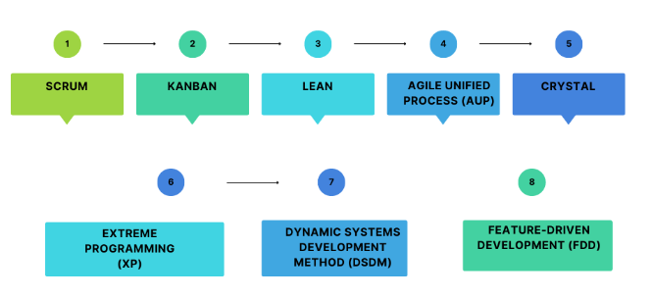
Agile Frameworks

Slide 118
Video: Agile Scrum Framework
What Is Agile Scrum Framework?
Watch this video to learn :
https://www.youtube.com/watch?v=B7VucspZA68

Slide 119
Workshop Activity 1
Scenario 1: Mobile Banking App Development
A financial technology (fintech) company is developing a new mobile banking app to provide customers with a seamless and secure banking experience. The app aims to offer features such as account management, fund transfers, bill payments, and real-time notifications. Given the competitive market and the need for rapid delivery of new features, the company adopts Agile methodology to manage the project. The development team consists of software developers, UX/UI designers, testers, and a product owner.
Discuss in your groups:
What are the key benefits of using Agile methodology for this mobile banking app development project?
How does the Scrum framework help in managing this project?
What roles do the product owner and UX/UI designers play in the Agile team?

Slide 120
Workshop Activity 2
Scenario 2: E-commerce Website Overhaul
An established e-commerce company is overhauling its website to improve user experience, integrate new payment gateways, and enhance search functionality. The project is crucial for maintaining competitive advantage and ensuring customer satisfaction. The company decides to use Agile methodology to manage the project, allowing for iterative development and frequent updates. The team includes web developers, database administrators, content creators, and a Scrum Master.
Discuss in your groups:
Why is Agile method suitable for this e-commerce website overhaul project?
What are the primary roles of the Scrum Master and content creators in this project?
How does Agile methodology support frequent updates and user feedback integration in this project?

Slide 121
Workshop Activity 3: Open Questions
Discuss in your group with the help of an online search platform:
How does the iterative approach of Agile methodology help in managing changes in project requirements?
In what scenarios might the Waterfall methodology be more advantageous than Agile for a project?
Why is effective resource management crucial for the success of an IT project?
What strategies can be employed to handle scheduling conflicts in a project with tight deadlines??
What are the benefits of using Gantt charts in project planning and scheduling?

Slide 122
Workshop Activity 4: Infographic summary
◆ Students are required to list the concepts that have been covered in the reading materials and lecture and group them by their category.
◆ Use an online tool (such as https://www.canva.com/ ) to produce the infographic summary to be submitted and present to the class.

